Slide 1

Advanced Doorbell to prevent COVID-19 using Arduino NANO
Sri Chandrasekharendra Saraswathi
Viswa Mahavidyalaya
Batch Number: 78
Presented By:
V K Ramdas Coudinya(11189C190)
R V Sarath Kumar(11189C193)
T Ravi Teja(11189C222)
Guided by:
A. Niranjan, Assistant Professor
Department of ECE
SCSVMV (DEEMED UNIVERSITY)
KANCHIPURAM.

Slide 2
PLAN OF PRESENTATION
Objective
Abstract
Introduction
Literature survey
Existing Vs proposed system
Block diagram
Hardware requirements
Software requirements
Advantages of the project
Disadvantages of the project
Applications of the project
Progress of the project
References

Slide 3
Objective
Protecting our loved ones and ourselves from the deadly coronavirus by restricting entry to our house to only people with a normal body temperature. So, our objective is to build a smart anti-corona doorbell using an Arduino Nano.
As COVID-19 is becoming worse day by day it is important for to be safe ourselves and ensure safety to our family. As we cannot measure a person’s temperature at home. So, for the safety concerns, we install this advanced doorbell at the entrance of our house to measure the visitor’s temperature and then by using it we can decide whether to let them in or not which ensures safety.
Thus, the main idea of the project is to ensure safety through technology.

Slide 4
Abstract
In this project, we will be designing an advanced doorbell that ensures safety from COVID-19 pandemic as it is fully touch proof. What If the person who came to our house cannot find the doorbell or if the person is has fever or if they maybe covid affected, what can be done to ensure?
How will it be if we use an automatic doorbell which checks their temperature and gives us instructions whether it is safe or not to let them inside and ring bell only when he is good? There are no more hassles.
The person who comes to our house need not search for the doorbell and press it any more. If we install this automatic doorbell using object detection circuit on the door itself, the circuit will automatically sense the presence of the person and ring the doorbell.

Slide 5
Introduction
The necessity for some means by which someone on the outside of a door could notify someone on the inside of his presence has been recognized for centuries. The earliest solution to this problem consisted of the simple expedient of knocking on the door with one's fist. As the human race grew in wisdom and technical sophistication, new and subtler methods were invented. The first of these was the mechanical door knocker, which saved man untold pain from bruised knuckles.
Then came the mechanical switch method requires that a mat containing many such switches be placed in front of the door in such a way that anyone approaching the door must step on it. Not only are such mats highly unesthetic, but it must be connected to the sound producing unit inside the house, requiring that a hole be drilled through a wall. This sort of installation is beyond what most homeowners have the time or skill to attempt, and is therefore usually done by professionals, greatly increasing total cost.

Slide 6
Introduction
The photoelectric method requires that a light source and photodetector be mounted on either side of the path leading to the door. Here again, installation is usually done by professionals, and unless it is possible to hide the units in shrubbery, the light source and detector can be even more unesthetic than a mat.
Installation of a doorbell based on a capacitance proximity sensor is somewhat simpler than that of a mechanical switch or photoelectric unit in that the entire device can be mounted on the inside of the door. However, in order to obtain even the minimal detection range of two feet, metal sensor plates of several square feet must be used, and while these cannot be seen from the outside, they are painfully obvious from the inside.
In order to overcome the disadvantages of the methods discussed, it is clear that the ideal automatic doorbell would consist of a single small battery-operated unit, requiring no electrical connections at all. Installation would consist of driving a nail into the door and hanging the unit from it. The automatic doorbell herein described seeks to meet these criteria.

Slide 7
Literature survey
Smart Bell Using IOT.
Ambika, Baswaraj Gadgey, Veeresh Pujari, Pallavi B V,
International Journal for Research in Applied Science & Engineering Technology (IJRASET) (2017).
IoT smart bell notification system :Design and implementation.
Woo-hyuk park and Yun-gyung cheong
19th International Conference on Advanced Communication Technology (ICACT) (2017).
Raspberry Pi Based Smart Doorbell.
Jie-Ci Yang , Chin-Lun Lai, Hsin-Teng Sheu and Jiann-Jone Chen
MDPI journal(2016)
Arduino based Wireless Door bell
Anusha(Electronics Hub)

Slide 8
Smart Bell Using IOT
Author: Ambika, Baswaraj Gadgey, Veeresh Pujari and Pallavi BV.
This paper gives basic idea of how to remotely monitor and control door. It will work as and when bell rings at the door or any motion is sensed at the door, it will act as a trigger to the camera and the camera will capture the image of the person standing in front of the door, that will be shown to the registered user who is away from home and then he will identify the person and through the web server he can control the door lock.
Smart home security control system has become indispensable in daily life.
The design and development of a home security system, based on human face recognition technology and remotely monitoring technology, to confirm visitor identity and to control door accessibility has been reported in this paper.

Slide 9
IoT smart bell notification system : Design and implementation
Authors: Woo-hyuk park and Yun-gyung cheong.
In this paper, they provide a security system that combines the functions of smart phone and home network system. It enables the users to monitor visitors in real-time, remotely via the IoT-based doorbell installed near the entrance door to a house.
If an outsider breaks into the house, the system can help identify the trespasser by acquiring CCTV evidence. Furthermore, this system can be used to report to the police or home security service provider immediately when a trespass occurs.
The design and development of a home security system combined with the functions of smart phone and home network system to confirm visitor identity has been reported in this paper.

Slide 10
Raspberry Pi Based Smart Doorbell
Authors: Gopal Kumar, Ankit Mishra, Dhiraj Kumar, Asst. Prof. H.S. Hemane.
The proposed system will allow to communicate between visitors and owners of the house. Video camera system (the photo of visitors will be sent to the owner of the house), instant message notification, SMS / MMS notification and dual audio / single sided process will be provided with videophone.
In addition, cloud storage of image data with a high resolution will be provided using the system With increasing safety and security is-sues, the use of smart door system increased consistently with the advent of security related electronics, such as digital door locks, advanced video conversation devices, and wire-less home security networks.
The design and development of a home security system combined with the functions of video camera system along with cloud storage to ensure security has been reported in this paper.

Slide 11
Arduino based Wireless Doorbell
Author: Anusha(Electronics Hub)
The aim of this project is to design a simple and cost efficient wireless doorbell. This project is designed an Arduino based Wireless Doorbell using simple hardware.
The project is implemented using RF Module for wireless communication and also an Arduino UNO board to analyze the data
In order to ring the bell (or buzzer in this case), we need to push the button on the transmitter side of the circuit. When the button is pushed on the transmitter side, a logic ‘0’ will be detected by the Encoder IC. The Encoder IC will transmit this data serially through the RF Transmitter Module.
The transmitted data will be received by the RF Receiver Module and is given to the Decoder IC. The Decoder IC, then decodes the serial data to parallel data and transmits the Logic ‘0’ to Arduino. In the Arduino UNO’s, he Arduino, the buzzer is turned on. Hence, whenever the button is pressed, the buzzer is turned on wirelessly.
The design and development of a home security system combined with the functions of RFID based system to ensure security has been reported in this paper.

Slide 12
Existing system
Proposed system
The existing system is the conventional old system in which the visitor has to press the switch in order to ring the doorbell. This involves touch which has become dangerous these days.
In the system that we propose, there is no need for a visitor to search for the switch, then press the switch in order to ring the doorbell. This system will automatically detect their presence, thus avoiding touch.

Slide 13
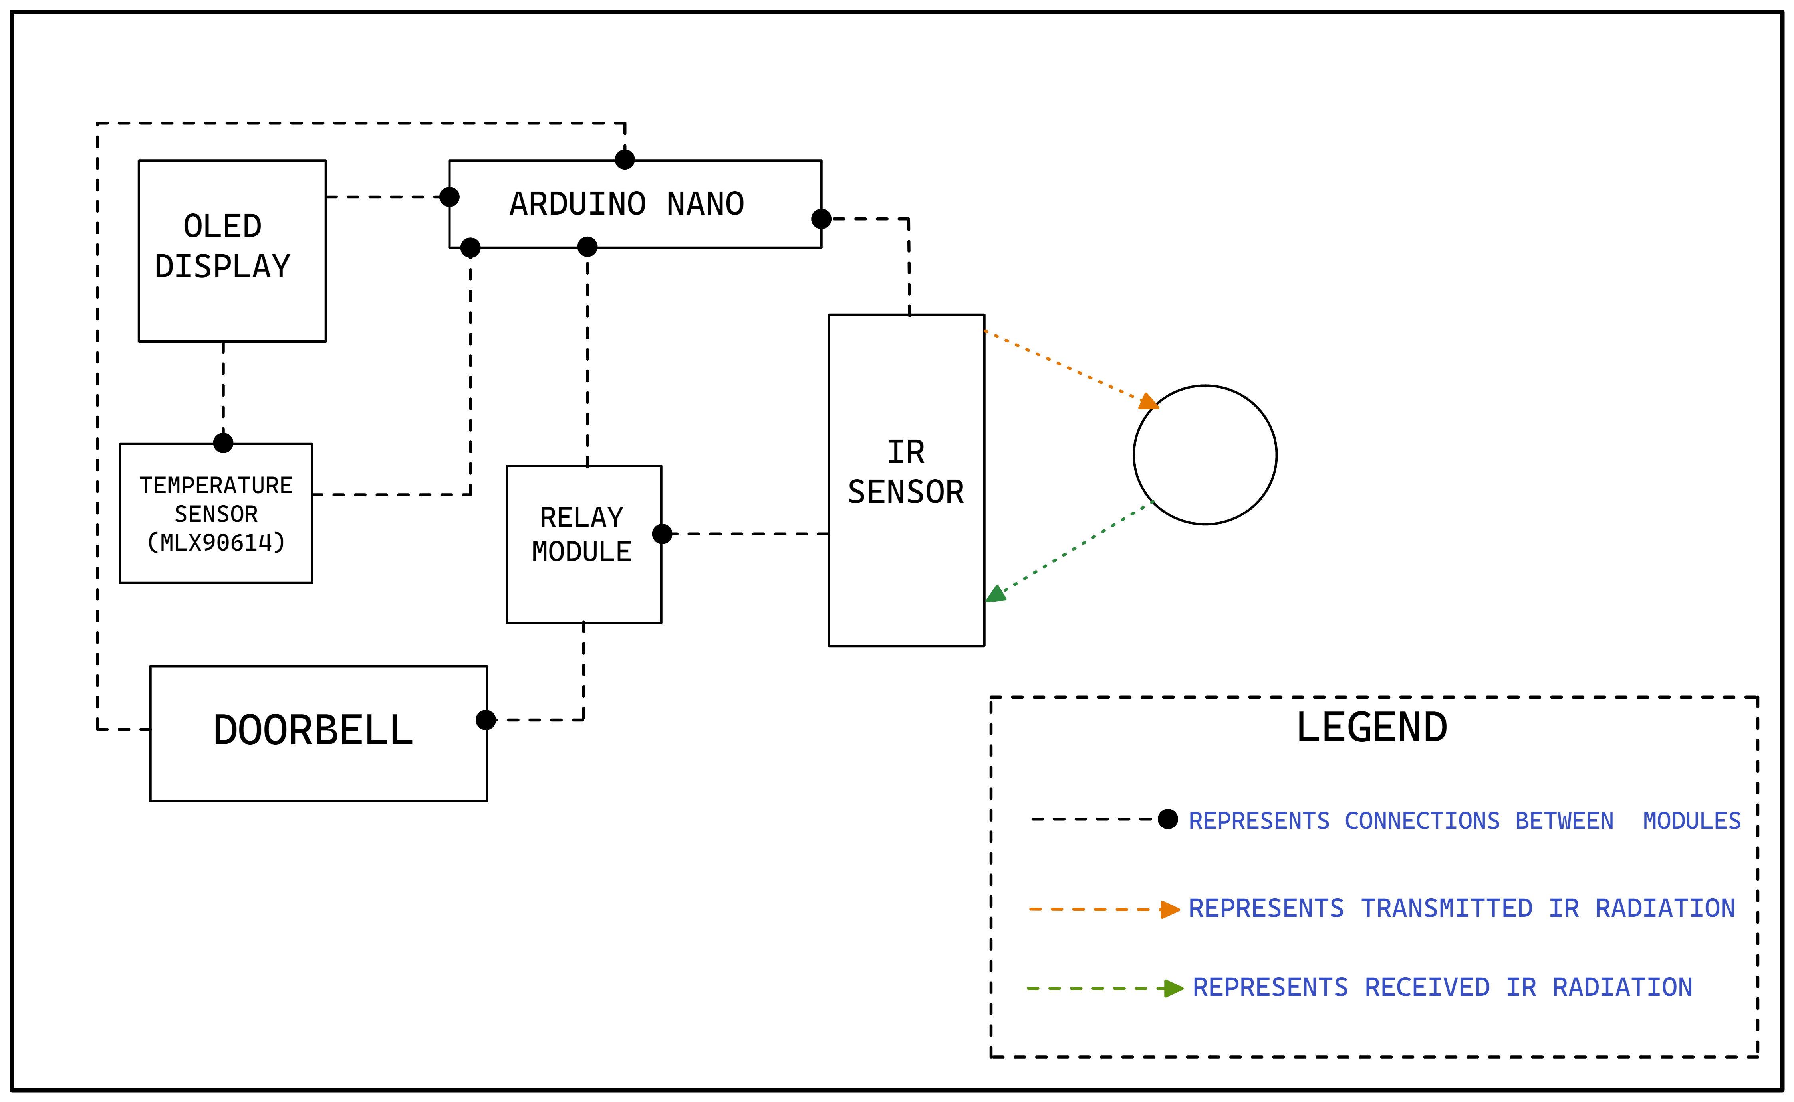
Block diagram

Slide 14
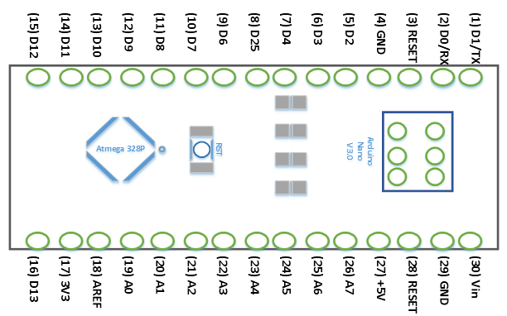
ARDUINO NANO Hardware

Slide 15
ARDUINO NANO
The Arduino Nano is a small Arduino board based on ATmega328P or ATmega628 Microcontroller. The connectivity is the same as the Arduino UNO board.
The Nano board is defined as a sustainable, small, consistent, and flexible microcontroller board. It is small in size compared to the UNO board. The Arduino Nano is organized using the Arduino (IDE), which can run on various platforms. Here, IDE stands for Integrated Development Environment.
The devices required to start our projects using the Arduino Nano board are Arduino IDE and mini USB. The Arduino IDE software must be installed on our respected laptop or desktop. The mini USB transfers the code from the computer to the Arduino Nano board.

Slide 16
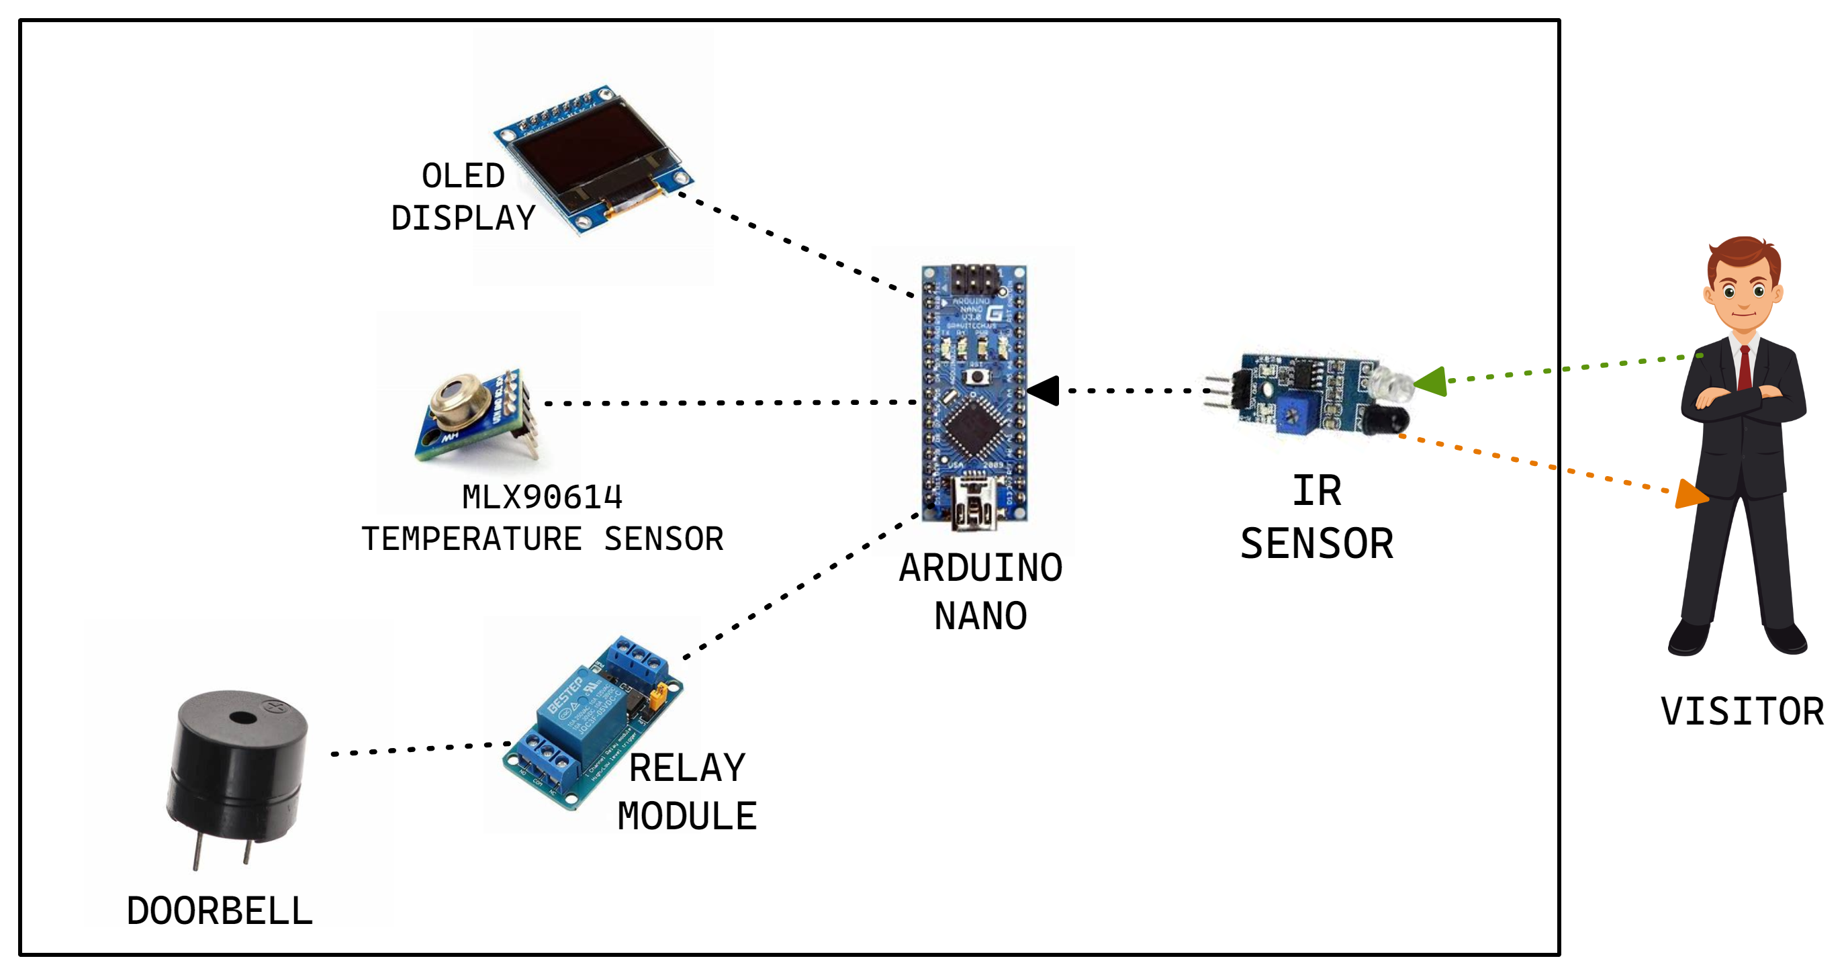
Schematic diagram of the project

Slide 17
Hardware Requirements
OLED Display
Bread Board
ARDUINO NANO
IR sensor
Temperature Sensor(MLX90614)
Door Bell/ Buzzer
Relay Module
Jumper wires (for connecting components)

Slide 18
Functioning of Hardware Components
OLED Display :
The OLED (Organic Light-Emitting Diode) display is an alternative for LCD display. The OLED is super-light, almost paper-thin, flexible, and produce a brighter, crisper and a better picture.
Bread Board :
A breadboard, or protoboard, is a construction base for prototyping of electronics.
ARDUINO NANO :
The Arduino Nano is a small, complete, and breadboard-friendly board based on the ATmega328 (Arduino Nano 3.x). It has more or less the same functionality of the Arduino UNO or MEGA, but in a different package. It lacks only a DC power jack, and works with a Mini-B USB cable instead of a standard one.

Slide 19
Functioning of Hardware Components
Temperature Sensor(MLX90614) :
The MLX90614 sensor uses non-contact temperature sensing to collect temperature information without touching any specific surface. Although invisible to the human eye, all objects emit infrared light, and the concentration varies with temperature.
Door Bell/ Buzzer :
The buzzer is a sounding device that can convert audio signals into sound signals. It is usually powered by DC voltage. It is widely used in alarms, computers, printers and other electronic products as sound devices.
Relay Module :
A 5v relay is an automatic switch that is commonly used in an automatic control circuit and to control a high-current using a low-current signal. The input voltage of the relay signal ranges from 0 to 5V.

Slide 20
Functioning of Hardware Components
IR sensor :
An infrared sensor (IR sensor) is a radiation-sensitive optoelectronic component with a spectral sensitivity in the infrared wavelength range 780 nm … 50 µm. IR sensors are now widely used in motion detectors, which are used in building services to switch on lamps or in alarm systems to detect unwelcome guests.

Slide 21
Software Requirements
PC with ARDUINO IDE installed.
Adafruit Library(used for OLED and MLX90614 temperature sensor)

Slide 22
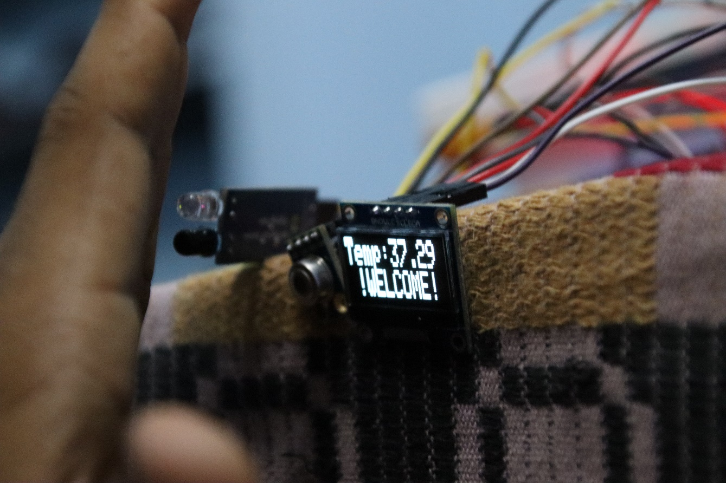
Results and Discussion
Case 1: If the measured temperature of the object is less than or equal to the defined temperature, then the following message will be printed on the screen.

Slide 23
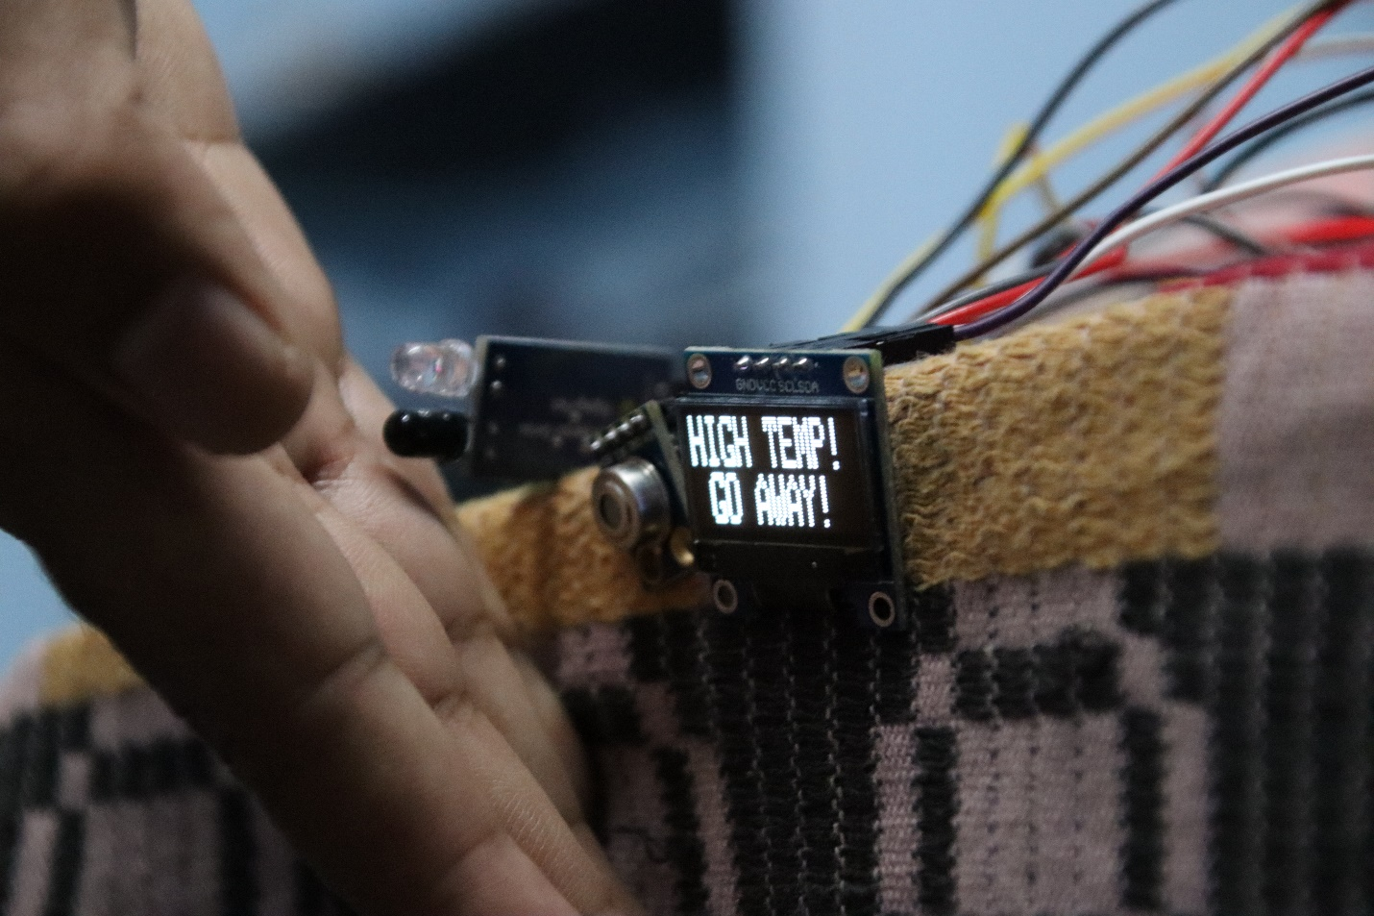
Results and Discussion
Case 2: If the measured temperature of the object is greater to the defined temperature, then the following message will be printed on the screen.

Slide 24
Advantages of the project
As there is a temperature sensor in this doorbell, we can easily identify people with high temperature and save ourselves from getting infected.
Safety is guaranteed by all means.
It is easy to install and is portable.
It is very affordable.
It also saves electricity, searching time for doorbell and manpower.

Slide 25
Disadvantages of the project
The only disadvantage that a wireless doorbell poses has been that it most often works on batteries. Now we don’t always check the battery charge of our doorbell every day. Consider the case when the battery gets discharged and if we are not conscious of this fact, what follows may be troublesome. A visitor might come and we might not be aware of it as our as the doorbell is dead, but this is a small disadvantage that can be ignored as the advantage of having a wireless doorbell are numerous. So this one problem cannot make the entire product offering obsolete.

Slide 26
Applications of the project
The Wireless Doorbell implemented in this project is just a demonstration of the idea. But the idea can be extended to actual, real time wireless doorbell system.
The project is suitable for homes, shops, garages, hospitals, offices etc.
Since the mode of communication is IR, thermal radiation can be easily infrared sensor.

Slide 27
Future scope of the project
This research can be further extended by linking it to devices through IOT. This will help in reducing the manpower to check the temperature. In the future aspect it can connect to the emergency medical services.
In general, this product will provide an extra layer of safety from COVID-19 infection by making automatic decisions through the developed system as there is potential chance of new variants of COVID may arise in the coming days, the process of primary detection of temperature is very important. This can be easily done by this automated doorbell.

Slide 28
Conclusion
The ARDUINO is a trivial and compact processor which is having high computing power contrary to its size. ARDUINO has its own impact for its computing, processing speed and multiple functions which can be used to program and to interface manifold devices in the real time and it is précised by the C++ programming language which is simple, highly efficient, powerful and optimal. Subsequently ARDUINO can be appropriate for the high compatible, reliable and scalable purpose in numerous applications.
This type of doorbell system has an immense impact in the busy human lifestyle to simplify their efforts to keep them and their away from a deadly disease like COVID-19 through this optimal solution.

Slide 29
Publication/Presentation

Slide 30
References
Arduino based Wireless Doorbell :www.electronicshub.org/wireless-door-bell
Ambika, Baswaraj Gadgey, Veeresh Pujari, Pallavi B V “Smart Bell Using IOT” International Journal for Research in Applied Science & Engineering Technology (IJRASET) (2017).
Woo-hyuk park and yun-gyung cheong “IoT smart bell notification system: Design and implementation” 19th International Conference on Advanced Communication Technology (ICACT) (2017).
Jie-Ci Yang , Chin-Lun Lai, Hsin-Teng Sheu and Jiann-Jone Chen “An Intelligent Automated Door Control System Based on a Smart Camera” http://www.mdpi.com/journal/sensors (2016).

Slide 31
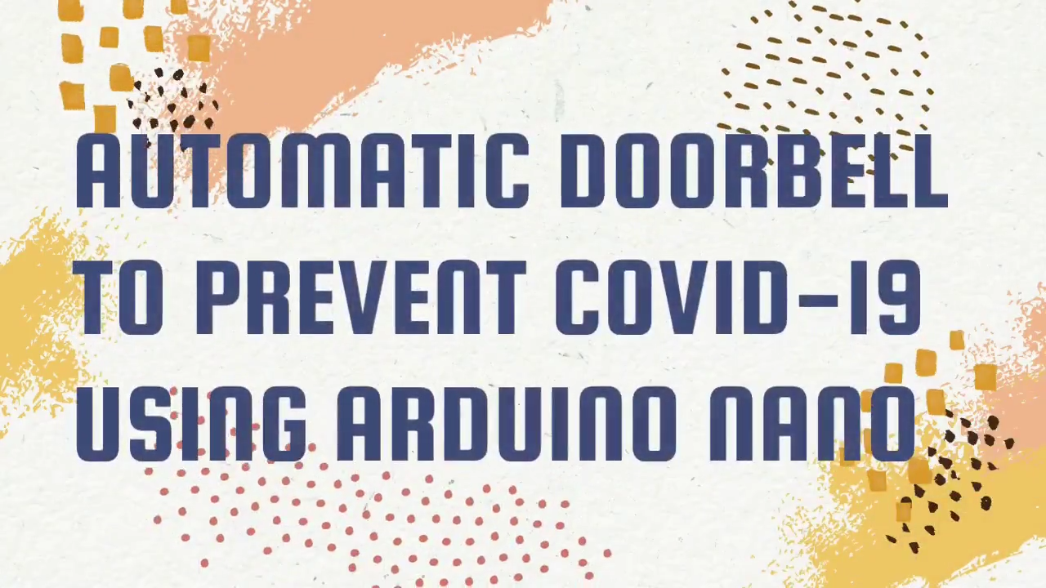
Demo of the project

Slide 32


